Slide 1
Communicating, Perceiving, and Understanding
Chapter 4
University of Colorado Denver

Slide 2
Perception
Our perceptions largely determine our understanding and our actions
How we perceive people affects how we treat them; how others perceive you affects how they treat you
  This affects their/your understanding of identity, and in turn, affects how they/you treat others
Each person’s perception of an event is different
Our perceptions are not objective lenses – there is no “Truth”

Slide 3
What is Perception?
An active process of:
  Selecting
  Organizing
  Interpreting people, objects, events, situations, and activities
When an individual deviates from the socially-accepted performance associated with an identity, they are pressured to change their performance
  They become victims to exclusion, bullying, and violence

Slide 4
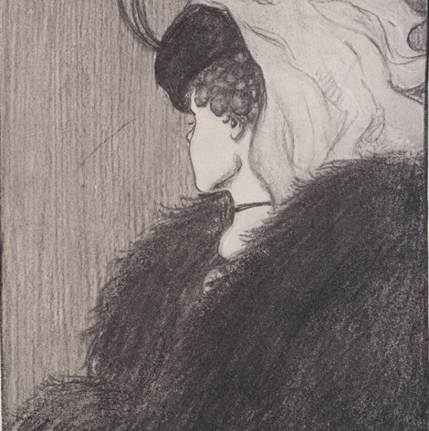
Selection
What stands out - salient stimuli
  What are you focused on?
  What gets lost in the background?
b) Our identities, needs, motives, and interests influence what we selectively perceive
  Stimuli familiar to you
  Stimuli of interest to you/your goals

Slide 5
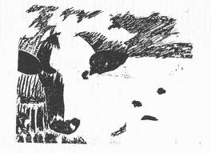
Organization
Ordering stimuli that we have attended to into a recognizable picture
Cognitive Representation – general outlines of patterns
  Prototype: ideal/most representative example of a category
  Interpersonal script: relatively fixed sequence of events that reflects expectations
Categorization – groupings w/ linguistic symbols
  Assigning labels/Reductionism
  Stereotyping

Slide 6
Interpretation
You are casually walking through your own neighborhood. You observe a female black kitten on the sidewalk in front of you. Do you:
  Want to lift, cuddle, and talk to her because she is soft, loving, and vulnerable?
  Step around but otherwise ignore her because you are simply not interested in cats?
  Avoid even looking at her, and cross to the other side of the street because in your mind you associate her with the devil and bad luck?

Slide 7
Interpretation
Subjective process of creating explanations for what we observe and experience
  Internal/external
Frames – filter/structure that shapes understanding
Attribution theory – drawing inferences about others’ behaviors
  Fundamental attribution error - giving more weight regarding one’s behavior to personal qualities/character and not external forces
  Self-serving bias - : blaming external forces when we perform poorly, but credit ourselves when performing well

Slide 8
Interpretation
Misunderstandings occur on the level of interpretation
  Arguably at the core of the majority of interpersonal comm. problems
  Subject to variance and error

Slide 9
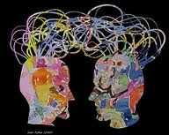
Individual Factors Influencing Perception
Physical factors
Personality characteristics
  Emotional state, outlook, knowledge
Cognitive complexity
  Ability to entertain multiple explanations
  How detailed, involved, or numerous a person’s constructs (categories) are

Slide 10
Societal Factors Influencing Perception
Power and privilege
Culture
Social comparison
  Ethnocentrism vs. ethnorelativity
  Stereotypes
  Prejudice
    Ego-defensive function
    Value-expressive function
Time
  Cohort effect (90s)
Social roles
Notes:
Joshua Bell concert tickets go for minimum $100 a person, yet many people passed him by on the subway and he only collected $32 from passerbys. He was playing on a 3.5 million dollar violin

Slide 11
Improving Perception Skills
Mindfulness
  What select stimuli am I attending to?
  What internal and external factors may be influencing my perceptions?
Understand the difference between facts and inferences
Perception-checking
  Checking with others to determine if their perceptions match their own
Monitor self-serving bias/fundamental attribution error

